Slide 1


caArray User Community Meeting
caArray User Community Meeting
2.2.0 Feature Overview and Review of MAGE-TAB Update and Export Specification
caIntegrator2 Presentation
Call in: 877-416-5524
Participant Passcode: 2627056
Centra: http://ncicb.centra.com
Meeting ID: ICR_meeting
November 5, 2008
Call in: 877-416-5524
Participant Passcode: 2627056
Centra: http://ncicb.centra.com
Meeting ID: ICR_meeting
February 3, 2010

Slide 2
Agenda
Update on caArray 2.3.1 Release
Support / Knowledge Center
caIntegrator2 presentation

Slide 3
Release Schedule
caArray 2.3.1
Release Date: Targeting February 5th, pending security scan.
caArray 2.3.1 Scope
  Export to GEO feature: Affymetrix single-channel CHP experiments
  17972: Allow deletion of already imported but not parsed data files
caArray 2.3.1 Status
  Application and installer testing concluded successfully.

Slide 4
What’s New on caArray Support
New Knowledgebase Articles
  caArray042: Is “user password” a required field for new user creation in UPT?
  caArray043: Manage the public visibility of a caArray experiment
  caArray044: Should my caArray grid service be Analytical or Data Service?
  caArray045: Unable to send user registration confirmation email
  caArray049: Workflow diagram for overall caArray operation
Community Code Contribution Update
  Matt Eldridge at Cambridge Research Institute has upgraded his batch upload/import extension to work with caArray 2.3.0.1
  Jim McCusker at Yale has developed a Nimblegen parser for caArray that is under testing

Slide 5
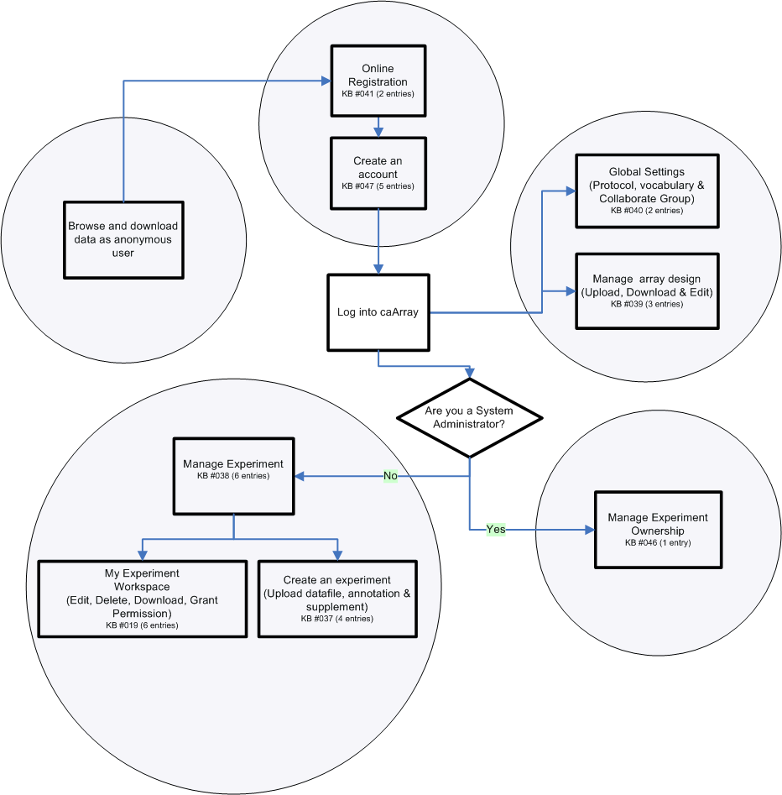
caArray049: Workflow diagram for overall caArray operation

Slide 6
caIntegrator2 Presentation

Slide 7
Avenues for Feedback
Molecular Analysis Tools Knowledge Center Forum
Gforge Community Change Request tracker:
  http://gforge.nci.nih.gov/tracker/?atid=1339&group_id=305&func=browse
This meeting
Next Meeting:
Wednesday, March 3, 2:00 PM ET

